Slide 1


Is Your Philanthropic Pie
Serving Up Success?

Slide 2
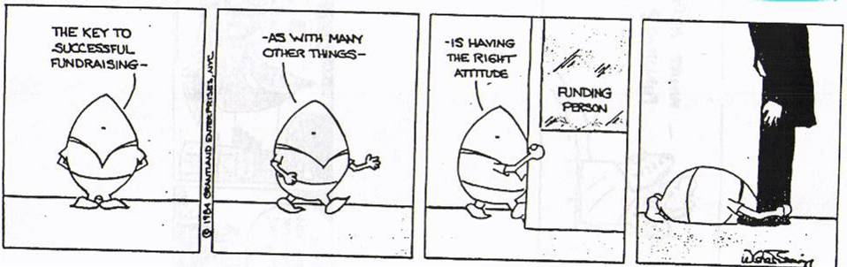

Slide 3

WHAT DOES YOUR CURRENT
PHILANTHROPIC MIX LOOK LIKE???
Annual Giving
State and Federal Funding
On line giving
Special Events
Foundation
Major gifts of $5,000 or more

Slide 4

WHAT DO YOU WANT YOUR IDEAL
PHILANTHROPIC MIX TO LOOK LIKE???

Slide 5
WHO IS CURRENTLY DOING YOUR FUNDRAISING???

Slide 6


WHAT WOULD YOU REALLY
LIKE THAT PIE TO LOOK LIKE???

Slide 7
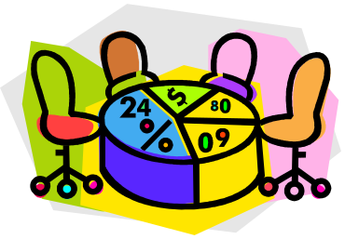

WHO ARE YOUR DONORS
WHAT DO YOU WANT THAT PIE TO LOOK LIKE???

Slide 8
WHAT ACTIVITIES DO YOU NEED TO DO
TO GET FROM CURRENT TO IDEAL???
________________________________________________________________________________________________________________________________________________________________________________________________________________________________________________________________________________________________________________________________________________________________________________________________________________________________________________________________

Slide 9

HOW CAN YOU GET TO YOUR DESIRED TEAM
DOING YOUR FUNDRAISING ???
________________________________________________________________________________________________________________________________________________________________________________________________________________________________________________________________________________________________________________________________________________________________________________________________________________________________________________________________

Slide 10

Some helpful tips
to make this all work!!

Slide 11
The Fund Development Continuum
Awareness
⬇
Understanding
⬇
Caring
⬇
Involvement
⬇
Commitment

Slide 12
SOLICITATION
is a:
once a year
one-step
one-ask
one-dimensional
contact.
CULTIVATION
is a
year round
gradual
open-ended
multi-dimensional
process.

Slide 13
Making the ASK
When??
Who??
How??
If both sides really want to make
the gift happen,
the details will not get in the way

Slide 14
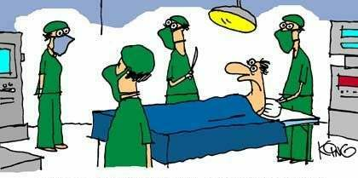
REMEMBER THAT THIS
IS NOT BRAIN SURGERY!
“Nurse, get on the internet, go to SURGERY.COM, scroll down and click on the ‘Are you totally lost?’ icon”
Page 33

Slide 15

How good are your
elevator speeches??

Slide 16
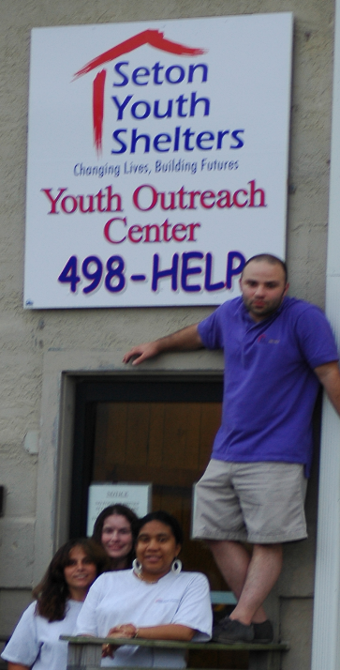
Have your prospects
“been to lunch”?

Slide 17
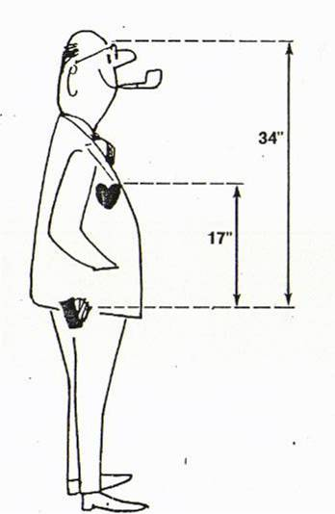
The distance from a prospect’s mind to his pocketbook is approximately 34 inches.
From his heart to his pocketbook is only 17 inches.
Aim for the heart – it is only
half the distance!!!

Slide 18

A B C
ALWAYS BE STEWARDING
It isn’t over with the solicitation!

Slide 19
“Most nonprofits have plenty of ideas on how to generate more money. What they need is help finding and following a structure, discipline, and process to move forward with their best ideas.”
Jim Thalhuber, V.P. of Development and Marketing
Goodwill/Easter Seals Minnesota
Page 23

Slide 20
FIVE GOALS FOR 2014 TO MAKE IT ALL HAPPEN
1.______________________________________________________________________________________________________________________________
2.______________________________________________________________________________________________________________________________3.______________________________________________________________________________________________________________________________4.______________________________________________________________________________________________________________________________5.______________________________________________________________________________________________________________________________

