Slide 1

ROUND 8
CONCEPT PAPER ORIENTATION
November 4, 2010

Slide 2
OBICI Healthcare Foundation
Strategic Priorities
Improve Access to Basic Healthcare
Obesity Prevention
Chronic Disease Management
Insure More People

Slide 3

Improve Access to Basic Healthcare
The uninsured rate in the Obici Healthcare Foundation’s service area ranges from 13% in Suffolk to 21% in Gates County, NC
Lack of access leads to poor health outcomes and excessive use of emergency rooms

Slide 4

Support to Make a Difference in:
Improving access to and utilization of:
  Primary care physicians
  Various oral health providers
  Low-cost pharmaceutical services
  Mental health services
  Medical transportation
  Basic healthcare services
  Preventive health screenings

Slide 5
Prevent Obesity
32% of American children/adolescents are overweight or obese; 16% of youth 2-19 fall into this category
Obese children who have an obese parent have a 50% chance of being obese; 80% chance if both parents are obese
African Americans are disproportionately overweight/obese
  Suffolk’s population is about 45% African American
Implementing strategies for children presents an optimum opportunity to make a difference

Slide 6

Support to make a difference in:
Developing comprehensive, evidence-based healthy lifestyle programs that improve nutritional and physical activity habits of children
Creating programs that demonstrate widespread community support and involvement.

Slide 7
Chronic Diseases Management
Chronic diseases are the leading cause of death in Virginia.
Chronic diseases defined:
  “Those illnesses that are prolonged, preventable, do not resolve spontaneously, are rarely cured completely and that pose a significant burden in mortality, morbidity and cost”
The Foundation’s focus on chronic diseases consists of:
  Heart disease (especially hypertension)
  Stroke
  Chronic Lower Respiratory Diseases (formerly known as COPD)
  Diabetes

Slide 8
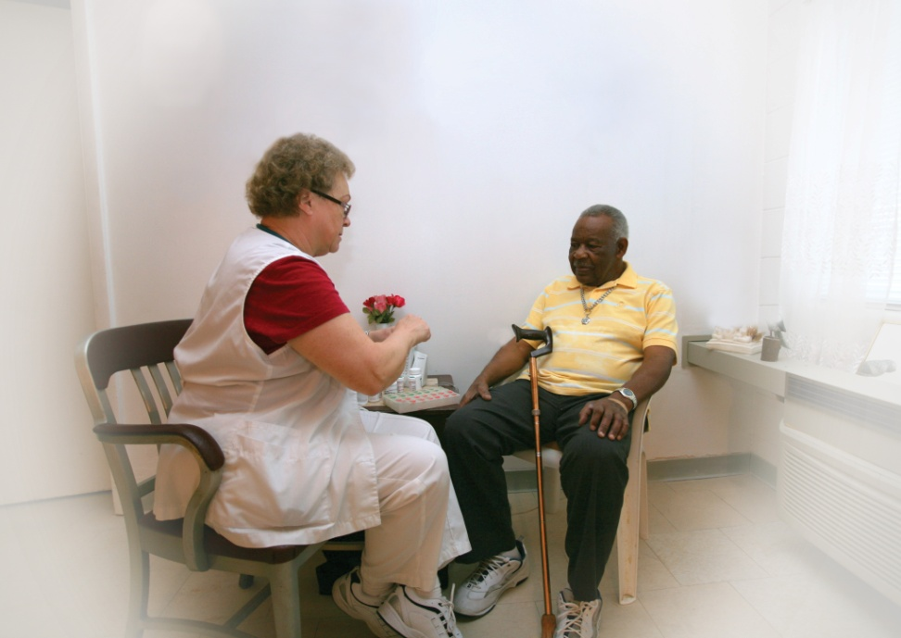
Support to make a difference in:
Creating cost effective programs centered on:
  Disease management (e.g., telehealth and home health nursing)
  Early intervention (e.g., smoking cessation)

Slide 9
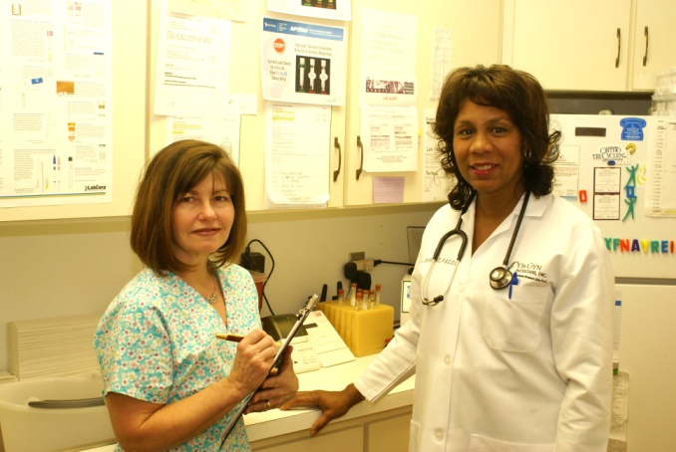
Insure More People
Facts about uninsured Virginians:
  1 million Virginians (15%) are uninsured
  The vast majority of uninsured Virginians were employed, living in households with at least one family member working full-time (64.6%) or part-time (15.2%).
  Many Western Tidewater residents qualify for employer sponsored medical insurance, but cannot afford the co pays or premiums
Access to health insurance is one of the top 10 leading health indicators
People with health coverage:
  Receive more medical care and more timely services
  Have better health outcomes
  Have fewer financial problems
  Have children with better long-term development

Slide 10

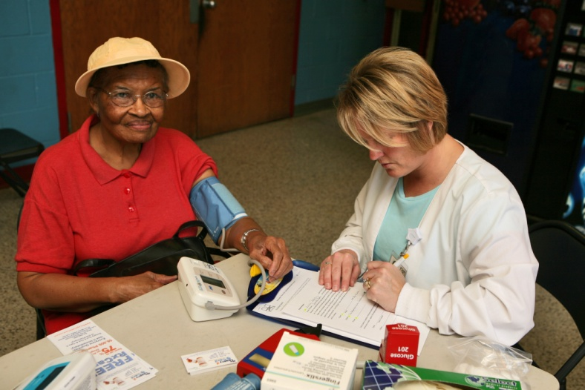
Support to make a difference in:
Increasing enrollment in:
  FAMIS
  Medicaid
  Medicare Part B and/or D
  Employer-based insurance

Slide 11
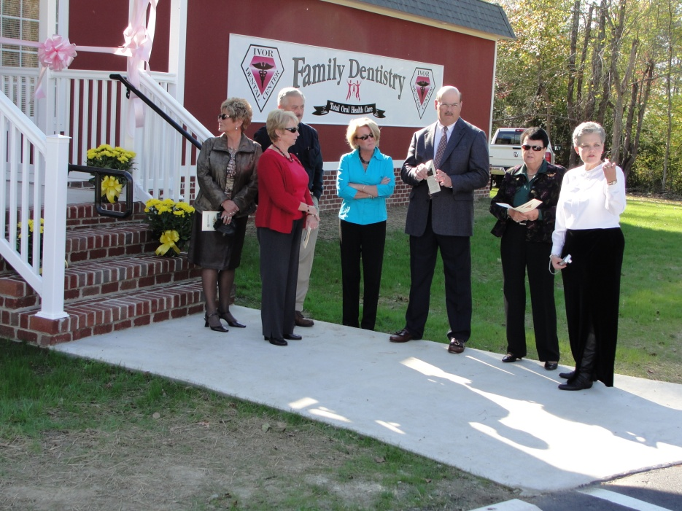
Concept Papers
Agency description
Unmet need
Target population/service area
Strategic Priority areas
Program overview
New or existing program
Evaluation process
Goals and objectives
Community partners
Preliminary budget

