Slide 1


Adapting to Change:
Forget the Past, Change Your Attitude, Press Forward, Be Courageous
Sister Peggy Scott, Franklin Virginia
Round 11 RFP Announcement

Slide 2


The Core of Change: Your Mission and Vision
  The mission and vision of every
  organization and every
  individual in this business
  is to make the world
  better for people.

Slide 3

Meet Change with Change
1. Don’t wait for change, make change happen.
2. Change is required when the current reality
is harmful, ineffective or unresponsive to
human needs.
3. Adapting to change = transforming reality.
4. Power is defining the transformation.
5. Transformation requires evidence, confidence
and commitment that produces vision.

Slide 4
Values and Skills Needed for Change
Creativity: (Flip It.)
Employ openness, originality, imagination, ingenuity, inventiveness, resourcefulness and vision.
Resiliency: (Laugh at it.)
Stand with strength, be durable and quick to recover, remain supple and always be feisty and buoyant.
Viability: (Don’t Gamble.)
Practice clear thinking and self honesty to assess feasibility and practicality; increase capability; take risks that turn possibility into achievement.

Slide 5

Practical Lessons About Transforming Reality
1. “Relationships are the basis of power.”
Marybeth Leymaster, The McCarty Institute
2. “You’ve got to smoke the hive to get the honey.”
Moses Quinby, “Mysteries of Beekeeping Explained”
3. “Figure out which way the
parade is going and get out
in front.
William S. Massey
4.”Too much is never enough.”
UPenn C.A. Eatery
5. “It’s a poor dog that can’t find a bone.”
John T. Skirven

Slide 6

Our Mission
“We help seniors to live with choice and dignity in their communities.”
Our Vision
“South Hampton Roads will become a livable community for all ages.”
Our Goal
“To develop and provide comprehensive, coordinated programs that assist seniors, their families and caregivers.”

Slide 7
Chesapeake | 14%
Franklin | 28%
Isle of Wight | 25%
Norfolk | 15%
Portsmouth | 20%
Southampton | 33%
Suffolk | 21%
Virginia Beach | 13%
South Hampton Roads | 16%

Slide 8
National Policies
Collaboration that creates regional capacity
Aging & Disability Resource Centers
Redirect revenues to evidence based programs
Evidence Based Wellness & Long Term Care Services
Increased need to grow HCBC capacity
Rebalancing Long Term Care
Tangible outcomes that demonstrate value
Livable Communities

Slide 9
Core Strategic Service Clusters
AGING AND DISABILITY RESOURCE CENTER
BENEFITS ACCESS
COMMUNITY BASED LONG TERM CARE
PLANNING AND ADVOCACY
TRANSIT
VOLUNTEER PROGRAMS
WELLNESS AND LIFESTYLE

Slide 10
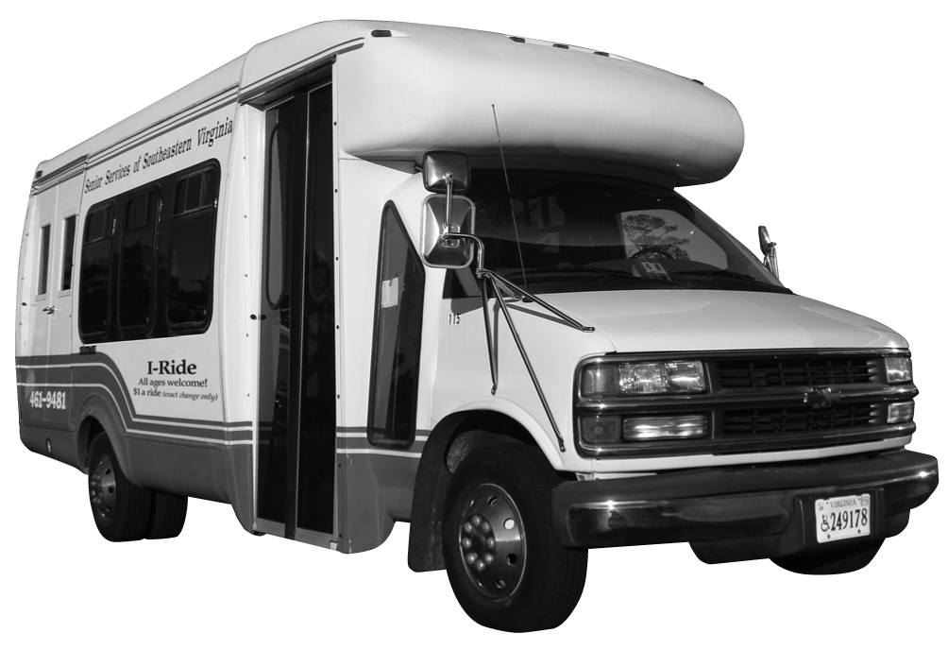
Need – Inputs – Outputs – Change - Outcomes
1972 – 2006: Change Happened to Us
Senior Center Transportation, Demand-Response Medical Transportation
2006 - 2007: We Saw a Need and Made Change Happen
I-Ride in Smithfield, Franklin and Southampton
2011: We did not know enough
Southampton – Franklin Transit Development Plan
Suffolk Public Transit RFP

Slide 11
Evidence of Change Impact

Slide 12
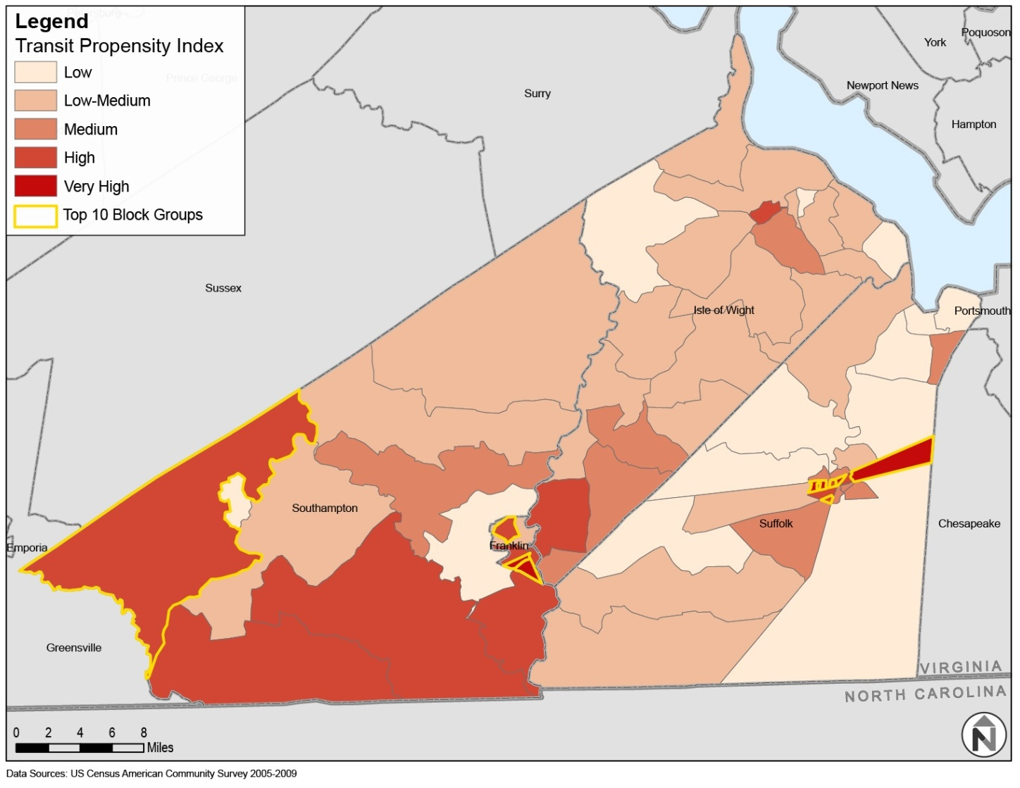
Transportation Service Dependency Index, by Block Group

Slide 13
Make Change Happen
2012: The Evidence is fueling the Vision
Coordinated Human Service Transportation Plan
Suffolk Public Para-transit
Volunteer Driver Program
Medicaid Transit Contracts
Private Transit Contracts
2013 – 2014: Implement the Vision
Implement the Coordinated Human Service Transit Network
Expand Suffolk Para-transit
Implement First Phase of Southampton-Franklin TDP
Win additional Fee-Generating Contracts

Slide 14
The Truth About Change
“Innovation is inherently complex”
Richard Browdie, CEO, Benjamin Rose Institute

