Slide 1
Virginia Community Healthcare Association
R. Neal Graham
Chief Executive Officer
November 13, 2012

Slide 2
Who Are We?
The Virginia Community Healthcare Association is comprised of twenty-six Federally Qualified Health Centers (FQHCs) and one Rural Health Center (RHC) that operate 122 healthcare delivery sites throughout the Commonwealth of Virginia. Two of the FQHC organizations are headquartered out-of-state.
Community Health Centers have been serving Virginia since 1970. The state association has existed for over 32 years.

Slide 3
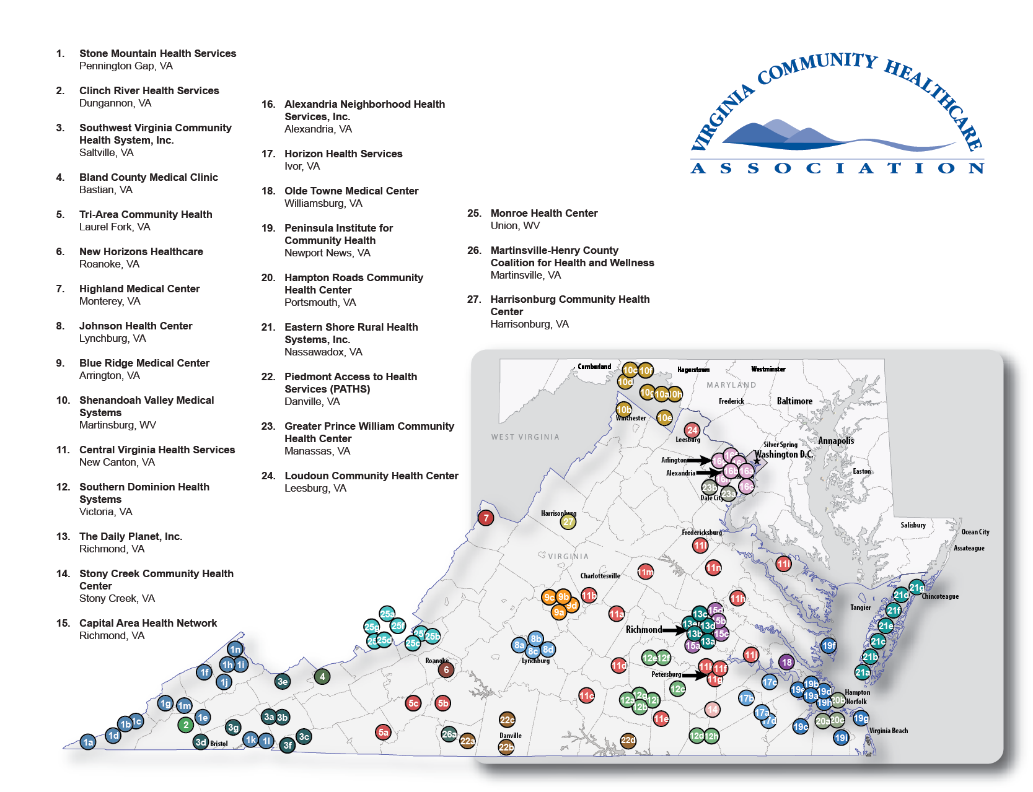
Where Are We?

Slide 4
What Do We Do?
Community Health Centers provide high-quality, comprehensive primary medical care services with a culturally sensitive, family-oriented focus to anyone needing care regardless of their ability to pay.
A Community Health Center must serve a defined geographic area that is federally designated, in whole or in part, as a Medically Underserved Area (MUA) or having a Medically Underserved Population (MUP). Most Community Health Centers operate in areas also designated as a Health Professional Shortage Area (HPSA).
Each Community Health Center is a separately incorporated non-profit organization governed by a local Board of Directors. A majority of the board’s membership must be consumers of services of the center.

Slide 5
How Are We Funded?
Medicaid,
SCHIP,
Medicare
Federal Grant
Support
22%%
29%%
Patient Pay,
Third Party
Reimbursement
23%
Resources Raised from Other Sources
26%
Total Funding for 2011:
$178,000,000

Slide 6
Who Do We Serve?
In 2011, Association members in Virginia conducted 1,070,000 patient visits for over 297,000 clients.
In 2011, approximately 63% of the patients seen by our members are at or below 150% of the federal poverty level - 38% were uninsured.

Slide 7
How Do We Operate?
Community Health Centers in Virginia employee over 300 physicians, dentists, behavioral health specialists, pharmacists, nurse practitioners and other healthcare providers. Total employment in 2011 was over 1700 employees.
In addition to direct care, Community Health Centers also offer lab, x-ray and other diagnostic services.
Community Health Centers also provide patient case management, interpreter/translation services, and referral services.
A center must offer extended hours to meet the needs of the patients. The extended hours vary from community to community.

Slide 8
What is the Future?
Unmet Need:
Over one million Virginians do not have health insurance.
Over 40% of all Virginia localities are designated as primary care shortage areas, over 60% are dental shortage areas, and over 70% are mental health shortage areas.
Declining number of primary care providers entering the workforce.

Slide 9
What is the Future?
Possible impact of the Affordable Care Act:
Medicaid Expansion – possible 250,000 to 425,000 Virginians would be eligible for coverage.
Health Benefit Exchanges – 90,000 to 100,000 Virginians would be eligible for subsidies and/or credits to purchase insurance.
Expansion of the National Health Services Corp could supply additional providers.
New funding for expansion of Community Health Centers.

Slide 10
How Are We Preparing for the Future?
All Community Health Centers have implemented Electronic Health Records and are on schedule to achieve CMS Meaningful Use certification.
All Community Health Centers are in the process of gaining NCQA recognition as Patient Centered Medical Homes and engaging in Team Based Care Models for practicing to the highest level of provider certification.
There is increased utilization of telemedicine.
There is increased utilization of telehealth services.

Slide 11
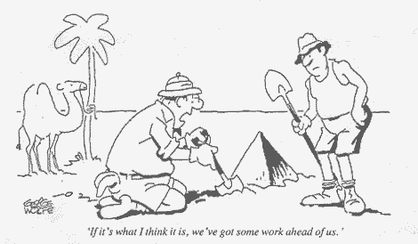

Slide 12
R. Neal Graham
Virginia Community Healthcare Association
3831 Westerre Parkway
Henrico, VA 23233
804-237-7677
800-966-8272
ngraham@vacommunityhealth.org

