Slide 1

Remaining Viable in Difficult Times II
Where the only thing that stays the same is change

Slide 2
and our mission…
“Breaking the cycle of homelessness and poverty for families and children”

Slide 3
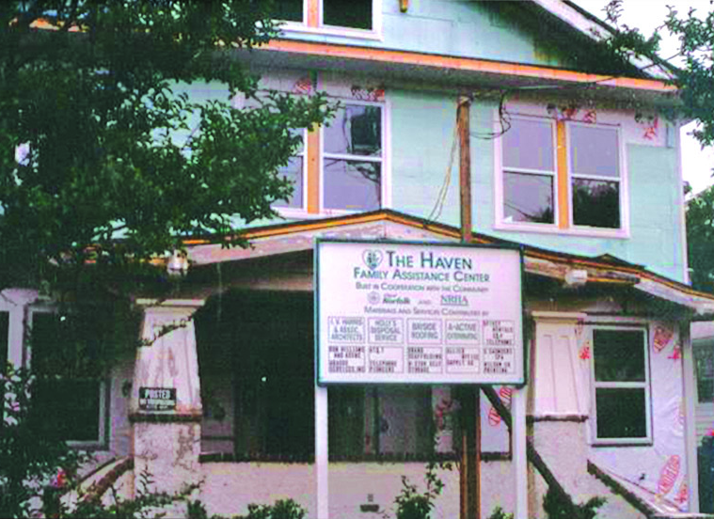
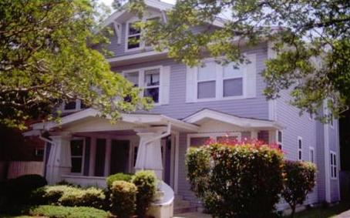
Founded in 1989 in Norfolk by members of 13 local churches
1989
Haven House 2009

Slide 4
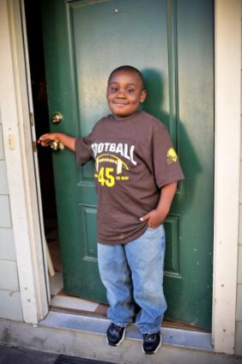
ForKids Today
7 Residential Facilities
  (56+ units)
12 Service Sites
  In three cities
75 Staff
  50 Full-Time
$4M Operating Budget
Daily Service Capacity: approx. 175 Families

Slide 5
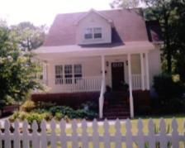

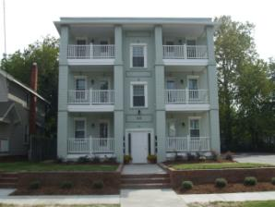
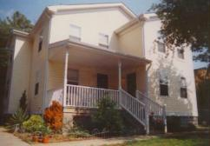
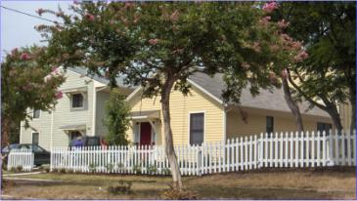
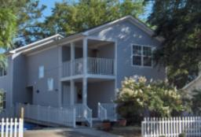
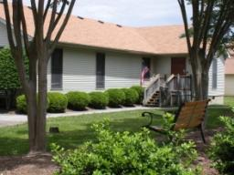
Our Facilities
Serving Norfolk, Portsmouth, Chesapeake, Virginia Beach,
Suffolk, Franklin, Isle of Wight & Southampton County
Notes:
5

Slide 6
Numbers Served
8% increase in FY11

Slide 7
Community Contributions

Slide 8

How did we get there?
Board Growth
A Clear Plan
Training
Smart Staff willing to change (and change again, and again…)

Slide 9
Changing Course
Moves that mattered

Slide 10
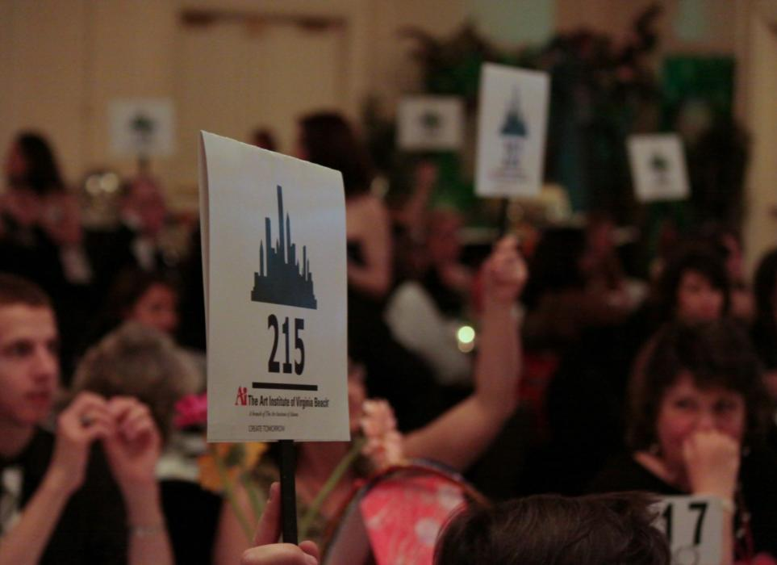

The Children’s Art Auction
--mission-centered fundraising
Moves That Mattered

Slide 11
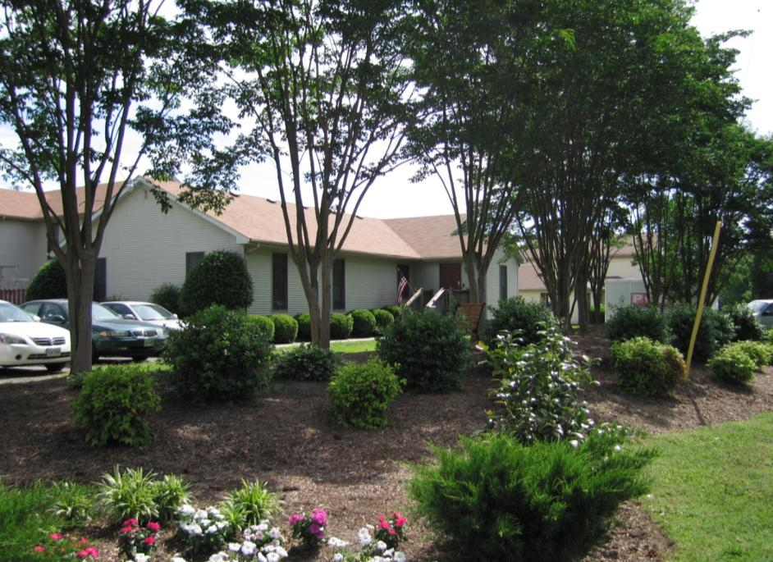
The Redesign of Western Tidewater Programs/Closing Suffolk House
--Radical rethinking (even when potentially unpopular)
Moves That Mattered

Slide 12

We got Good Mojo
--- earned income
Moves That Mattered

Slide 13

